Slide 1
The CARE Program
Dorene Beasley, CARE Program Manager
Andrea Parrett, CARE Coordinator

Slide 2
Learning Objectives
Understand the CARE Program Special Admissions that allow a patient to transfer from the hospital to a nursing facility.
Learn what information is required in the doctor’s order for it to be accepted as a Special Admissions to a nursing facility.

Slide 3
CARE
Kansas Department for Aging and Disability Services (KDADS), Behavioral Health Services Commission, Community Integration Division administers The Client Assessment, Referral and Evaluation (CARE) Program
Notes:
The CARE Team had resided in the Aging Division under the Long-Term Support Services Commission until October 2021. The CARE Team moved to the Community Integration Division of the Behavioral Health Commission. During the transition, the previous CARE Team staff moved to other KDADS positions. The Assistant Commissioner for Behavioral Health Services and the CARE & PASRR Director have been working to rebuild the CARE Team. A new CARE Program Manager was hired at the end of May. The 2 CARE Specialists have recently (August) transitioned from CARE Temporary positions. A CARE Coordinator position is in the process of being filled. Training continues for the new staff and for those that have been pulled in from other work on at KDADS. These changes and ongoing training along with a stockpile of information sitting in the KDADS CARE email from nearly a year ago has created delays in communication and delays in processing information.

Slide 4
CARE Purpose
The CARE program’s purpose:
Special Admissions allows someone to admit directly into a nursing facility under a physician’s order
CARE Level I assessment to people who want to/referred to a nursing facility and ensure the need for nursing level of care
PASRR (pre-admission screening and resident review) Level II evaluation to ensure that individuals with mental illness, intellectual disability and/or developmental disability (IDD/DD) are not moved into a nursing facility if they can be better served in a less restrictive environment
PASRR resident reviews for people currently in facilities
Notes:
To comply with Section 1919(e)(7) of the Social Security Act, every individual admitting to a Medicaid-certified nursing facility must have proof of a valid preadmission, screening, and resident review (PASRR) unless an exception applies via a Special Admission. In response to this requirement, Kansas developed the Client Assessment, Referral and Evaluation (CARE) Program to comply. The purpose of the CARE Program is to collect data, assess individuals, provide referrals to community-based services, and make appropriate placements in long-term care facilities.
The CARE pre-admission assessment received by all individual seeking admission to a Kansas nursing facility is called a “Level I CARE Assessment.” The Level I CARE assessment collects information regarding the individual’s contact and demographic information, PASRR status, and level of care needs, including: supports, cognition, communication, recent problems, and customer choice.
Exceptions to the Level I CARE Assessment are called “special admissions.” When an individual is admitted to a nursing facility as a special admission, a Level I CARE assessment is not required prior to admission. A qualified nursing facility employee must fill out Sections A and B of the CARE Assessment and submit additional documentation to the KDADS CARE Program. However, if the person will be in the facility long-term, a Level I Assessment will be required.
During a Level I Assessment, the need for Level II evaluation due to mental illness or intellectual disability or related condition may be identified. For consumer with a Level II Evaluation determination letter in facilities, a resident review is required near the end of their stay.

Slide 5
Kansas Process
Special Admissions
Emergency Admissions
Respite Stay
Out of State PASRR
Terminal Illness
Less Than 30 Days
PASRR Level II Evaluation
Full Level II Form
Resident Review
CARE Level I Assessment
Area on Agency Aging (AAA)
Hospital
Notes:
Nursing Facilities (NF) can receive doctor’s orders for Emergency Admissions, Less Than 30 Day Stay, Terminal Illness, Respite to admit someone directly into an NF. In addition, if the person has a Level I assessment or Level II evaluation out of state, that can be used (if within the appropriate timeframe) to enter a facility.
Special Admissions:
Emergency Admission
Less than 30-day Admission
Respite Stay
Terminal Illness
Out of State PASRR
If the person in the NF needs to stay longer, then a Level I assessment must be completed. A Level I assessment is the required assessment to stay in an NF long term by the federal government. Only trained assessors at the AAAs or hospitals can complete the Level I assessment. A person can enter an NF with a Level I assessment and no special admission.
Level I Assessment Area Agency on Aging and trained hospital assessors can complete Level I Assessments.
LEVEL II EVALUATIONS: A Level I assessment may trigger a Level II Evaluation for mental illness or intellectual or developmental disability. Only trained assessors at the AAAs or hospitals can refer the Level I assessment for the Level II evaluation. The Level II contract for evaluations is currently held by HealthSource Integrated Solutions (HIS)
Level II evaluation required to enter a nursing facility for mental health but can enter a nursing facility as well

Slide 6
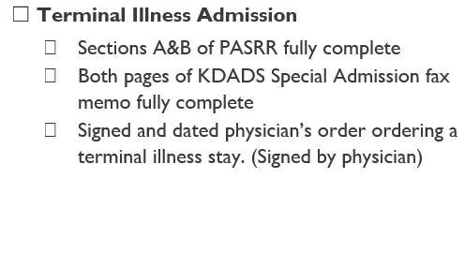
Terminal Illness
Physician Responsibilities
Order must indicate terminal illness with life expectancy of 6 months or less should condition run its natural course.
Orders must be signed by a physician.
Doctor’s order must be on letterhead or hospital forms indicating the location where the doctor assessed the individual for admission into a nursing facility.
Nursing Facility Responsibilities

Slide 7
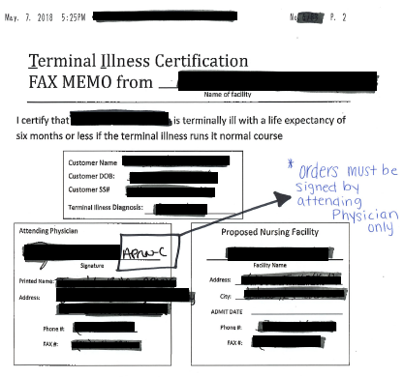
Terminal Illness
INVALID Terminal Illness Order

Slide 8
VALID Terminal Illness Order

Slide 9
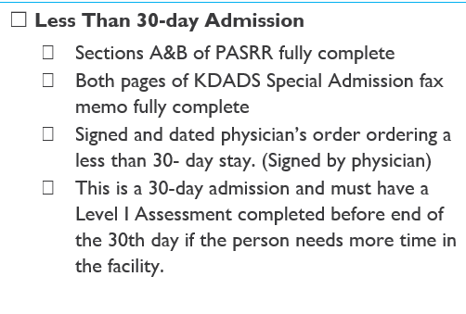
Physician Responsibilities
Less Than 30 Days
Doctor’s order must be on letterhead or hospital forms indicating the location where the doctor assessed the individual for admission into a nursing facility.
Nursing Facility Responsibilities
Less Than 30 Days – the doctor’s order must state
1. less than 30 days to skilled facility or similar
2. and be on the discharge paperwork from the hospital.
Orders must be signed by a physician.

Slide 10
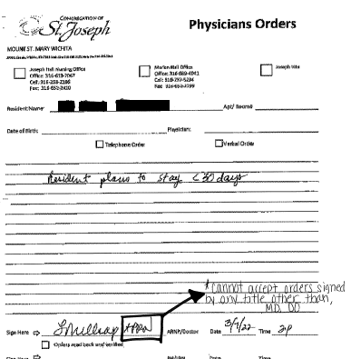
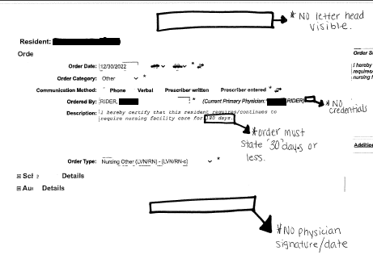
INVALID Less than 30 day Order

Slide 11
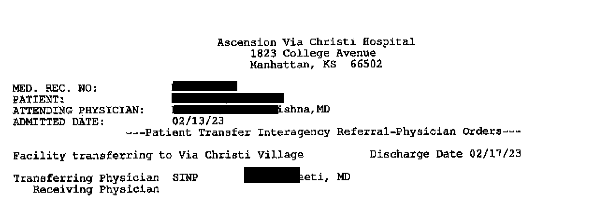
VALID Less Than 30-day Order

Slide 12
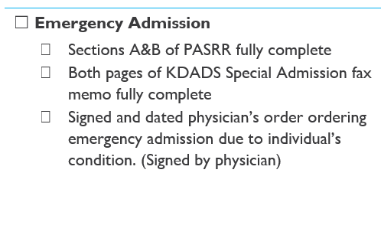
Emergency Admissions
Physician Responsibilities
Emergency Admissions – the doctor’s order must state
1. emergency admit or
2. urgent or
3. admit necessary due to health reasons and specify the reasons.
Nursing Facility Responsibilities
Orders must be signed by a physician.
Doctor’s order must be on letterhead or hospital forms indicating the location where the doctor assessed the individual for admission into a nursing facility.

Slide 13
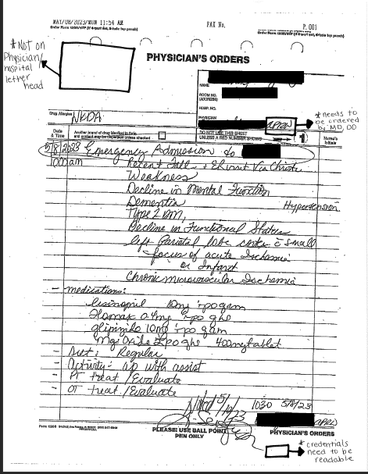
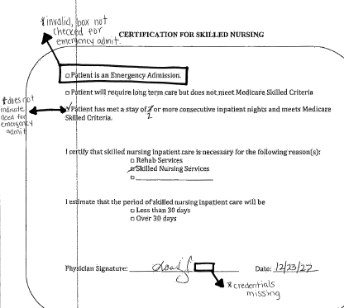
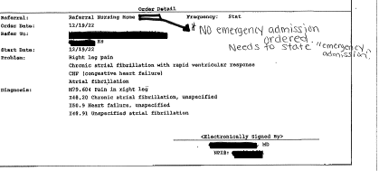
INVALID Emergency Admission Orders

Slide 14
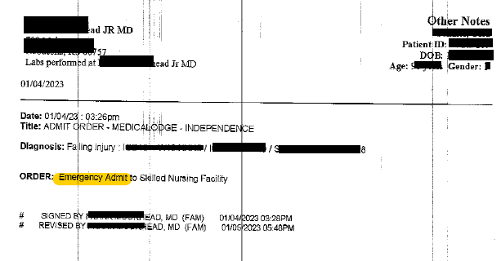
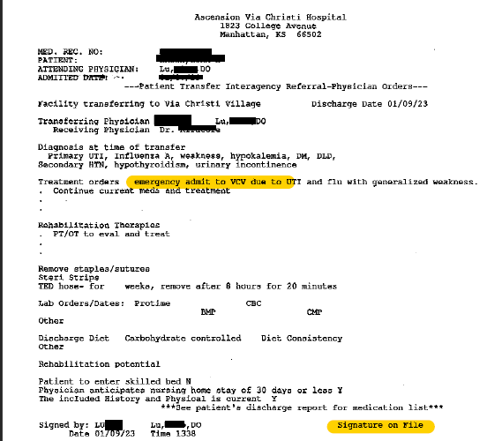
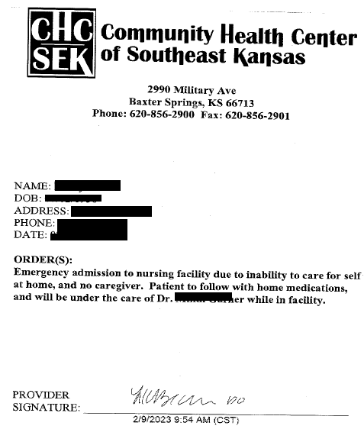
VALID Emergency Admission Orders

Slide 15
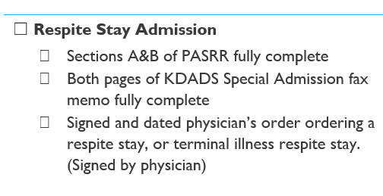
Respite Stay
Physician Responsibilities
The doctor’s order must state respite with admit and discharge dates
For Hospice Respite, the stay is 5 days
For Respite, the stay can be up to 30 days.
Orders must be signed by a physician.
Nursing Facility Responsibilities

Slide 16
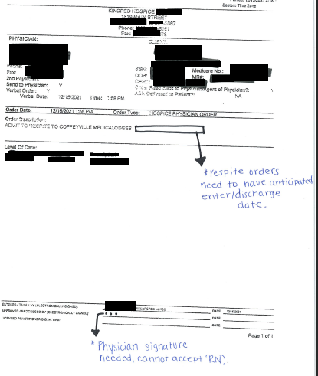
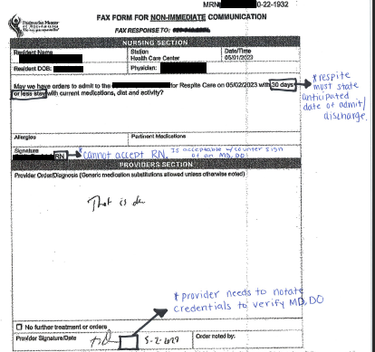
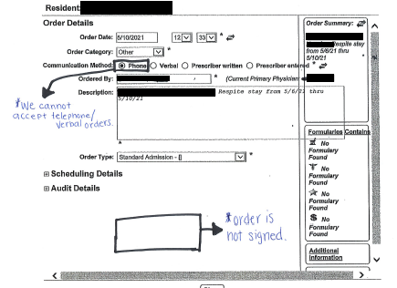
INVALID Respite Stay Orders

Slide 17
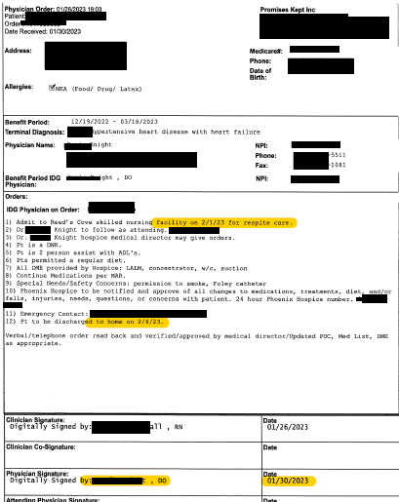
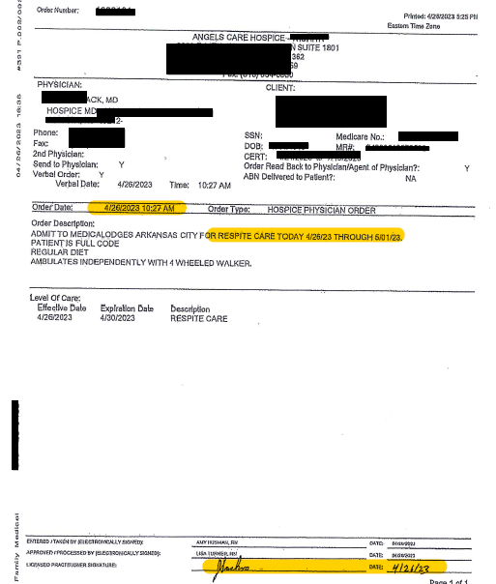
VALID Respite Stay Orders

Slide 18
Reminders
All orders must be signed by a physician. (Orders signed by RNs, APRNs, PAs, & PA-C are not accepted at this time). Exceptions may be considered for rural and other areas that lack accessibility
All signed orders must include the date physician signed the order.
All orders must include appropriate language specific to special admission type
All respite orders must include admission and discharge dates.
Electronic doctor's signatures are acceptable if the hospital or office has procedures/policies in place to use them
Notes:
If the person in the NF needs to stay longer, then a Level I assessment must be completed. A Level I assessment is the required assessment to stay in an NF long term by the federal government. Only trained assessors at the AAAs or hospitals can complete the Level I assessment. A person can enter an NF with a Level I assessment and no special admission.
Level I Assessment (required to stay in a nursing facility)
Area Agency on Aging and trained hospital assessors can complete Level I Assessments.
Assessment to determine if the person meets the physical needs for a nursing home and whether there is a need for further evaluation (Level II evaluation referral) due to mental illness and/or intellectual/developmental disability or related condition
A Level I assessment allows a person who meets the level of care required for an NF to choose to enter an NF at any time after the assessment up to 365 days (1 year after the date of the assessment).
For people who are in an NF via a special admission or who enter after the Level I assessment, the Level I is valid while the person is in the NF and up to 30 days after discharge.
LEVEL II EVALUATIONS: A Level I assessment may trigger a Level II Evaluation for mental illness or intellectual or developmental disability. Only trained assessors at the AAAs or hospitals can refer the Level I assessment for the Level II evaluation. The Level II contract for evaluations is currently held by HealthSource Integrated Solutions (HIS)

Slide 19
Future Plans
All facilities utilizing new Document Upload Tool beginning July 1, 2023
Development of a request for proposal to find a contractor for fully electronic process for CARE/PASRR
Expanded agreements with AAA and HIS for Level II referrals

Slide 20
Questions?
KDADS.CARE@KS.GOV
Andrea Parrett [KDADS]
Andrea.Parrett@ks.gov
Dorene Beasley [KDADS] Dorene.Beasley@ks.gov

Slide 21
Resources
Kansas Department for Aging and Disability Services CARE Information https://kdads.ks.gov/kdads-commissions/behavioral-health/client-assessment-referral-and-evaluation-(care) or https://kdadsˌksˌgov/provider-home/care-provider-information
PASRR Technical Assistance Center https://wwwˌpasrrassistˌorg/
Notes:
Handouts:
Quick fax
KDADS & KDHE

