Slide 1
Adult Care Home Regional Round Tables
November 4th-7th, 2024
Lacey Hunter, Commissioner
Dawne Altis, Assistant Commissioner
Survey, Certification & Credentialing

Slide 2
Topics for Today
State Licensed Only involuntary discharge reporting
Changes to Continuing Care Retirement Community certification since July 1, 2024
Receivership-what is it and how do you apply for it
CMPs, NATCEP and other enforcement remedies
Top deficiencies cited
Survey consistency
Notes:
Current for 10/7/2024

Slide 3
State Licensed Only Discharge Reporting
Involuntary Discharge
Just a reminder for State Fiscal Year 2025 the State Legislature passed a requirement for all assisted living facilities, residential healthcare facilities, home plus and boarding care homes to submit a report to KDADS upon the completion of every involuntary transfer or discharge of a resident.
Any facility that fails to submit a report within 60 days of the completion of the transfer or discharge or resolution of a formal complaint shall be subject to a civil penalty.
KDADS will compile the information into a report for the 2025 Legislature.
The reports shall not include personally identifiable information and shall include:
The date when notice of transfer or discharge was provided;
the date when the resident left the facility;
the type of facility where the resident was transferred or discharged;
the reason that required the transfer or discharge of the resident pursuant to K.A.R. 26-39-102(d);
if the resident was transferred or discharged pursuant to K.A.R. 26-39- 102(f), the reason that required such transfer or discharge;
if the resident filed a complaint regarding the notice of transfer or discharge; and
any other relevant information required by the secretary.
A user guide can be found : https://www.kdads.ks.gov/home/ showpublisheddocument/3958/638629312763930000
If you have any questions, please reach out to KDADS.InvoluntaryDischarge@ks .gov .
Notes:
Current for 10/7/2024

Slide 4
Changes to CCRc
Follow-Up Information
In response to an audit from the Medicaid Inspector General, HB 2784 makes several policy changes related to Continuing Care Retirement Communities.
It creates a statutory definition of what a CCRC is,
"Continuing care retirement community" means
any place or facility that combines a range of housing and services to encompass the continuum of aging care needs provided at an independent living facility, an assisted living facility, a residential healthcare facility, home plus or a skilled nursing care facility within a single place or facility to avoid the need for residents to relocate to a separate place or facility. The provision of community care includes the multiple levels of care provided as part of a continuing care retirement com-munity.”
Additionally, effective July 1, 2024, the legislation moves registration of CCRCs from the Kansas Insurance Department to the Kansas Department for Aging & Disability Services.
You can send correspond-ence related to CCRCs to KDADS.CCRCRegistrations@ks.gov
CCRC Application: Microsoft Word - Adult Care Home Licensure Application.docx (ks.gov)
CCRC Annual Disclosure Statement: ccrc-annual-disclosure-statement_fillable.pdf (ks.gov)
Notes:
Current for 10/7/2024

Slide 5
Receivership
Information
39-954ˌ Application for receiver; order appointing; qualifications of persons designated and method of selection, rules and regulations. (a) The secretary for aging and disability services, the owner of an adult care home, or the person licensed to operate an adult care home may file an application with the district court for an order appointing the secretary for aging and disability services or the designee of the secretary as receiver to operate an adult care home whenever: (1) Conditions exist in the adult care home that are life threatening or endangering to the residents of the adult care home; (2) the adult care home is insolvent; or (3) the secretary for aging and disability services has issued an order revoking the license of the adult care home.
(b) The secretary for aging and disability services may adopt rules and regulations setting forth the necessary qualifications of persons to be designated receivers and a method for selecting designees.
History: L. 1978, ch. 162, § 1; L. 1985, ch. 151, § 1; L. 2003, ch. 149, § 19; L. 2014, ch. 115, § 143; July 1.
39-955. Filing application for receivership; contents. The application for receivership shall be filed in the Shawnee county district court or the district court in the county where the adult care home is located. The application shall be verified and set forth the specific reasons therefor.
History: L. 1978, ch. 162, § 2; L. 2019, ch. 55, § 30; May 9.
Notes:
Current for 10/7/2024

Slide 6
Nursing Facility Enforcement
Federal Fees, Fines and Other Remedies
Federal Remedies for certified skilled nursing facility authority begins at
42 CFR 488ˌ400 and include three categories:
7400.6.1 - Category 1
(Rev. 63, Issued: 09-10-10, Effective: 09-10-10, Implementation: 09-10-10)
Select at least one remedy from category 1 when there:
• are isolated deficiencies that constitute no actual harm with a potential for more than
minimal harm but not immediate jeopardy; or
• is a pattern of deficiencies that constitutes no
actual harm with a potential for more than minimal harm but not immediate jeopardy.
EXCEPT when the facility is in substantial compliance, one or more of the remedies in category 1 may be applied
to any deficiency.

Slide 7
Nursing Facility Enforcement
Federal Fees, Fines and Other Remedies
CATEGORY 1 remedies include:
• Directed plan of correction (see §7500);
• State monitoring (see §7504); and
• Directed in-service training (see §7502).
NOTE: As an agent of CMS or the State Medicaid Agency, the State may impose one or more
category 1 remedies, as authorized by CMS or the State Medicaid Agency, in accordance
with §7314.

Slide 8
Nursing Facility Enforcement
Federal Fees, Fines and Other Remedies
7400.6.2 - Category 2
(Rev. 213; Issued: 02-10-23; Effective: 02-10-23; Implementation: 02-10-23)
Select at least one remedy from category 2 when there are:
• Widespread deficiencies that constitute no actual harm with a potential for more than minimal
harm but not immediate jeopardy; or
• One or more deficiencies (regardless of scope) that constitute actual harm that is not immediate
jeopardy.
EXCEPT when the facility is in substantial compliance, one or more of the remedies in
category 2 may be applied to any deficiency. NOTE: The State Medicaid Agency does not have the
statutory authority to impose the remedy of denial of payment for all Medicare and/or Medicaid
residents.

Slide 9
Nursing Facility Enforcement
Federal Fees, Fines and Other Remedies
CATEGORY 2 remedies include:
• Denial of payment for all new Medicare and/or Medicaid admissions;
• Denial of payment for all Medicare and/or Medicaid residents, imposed only by the CMS Location;
• Lower range per day civil money penalties;
• Per instance civil money penalties.

Slide 10
Nursing Facility Enforcement
Federal Fees, Fines and Other Remedies
7400.6.3 - Selection from Category 3
(Rev. 63, Issued: 09-10-10, Effective: 09-10-10, Implementation: 09-10-10)
Termination or temporary management, or both, must be selected when there are one or more
deficiencies that constitute immediate jeopardy to resident health or safety. A civil monetary
penalty of $3,050 - $10,000 per day or a civil money penalty of $1,000 - $10,000 per instance may
be imposed in addition to the remedies of termination and/or temporary management.
Temporary management is also an option when there are widespread deficiencies constituting
actual harm that is not immediate jeopardy.

Slide 11
Nursing Facility Enforcement
Federal Fees, Fines and Other Remedies
CATEGORY 3 remedies include:
• Temporary management (see §7550);
• Termination (see §7556);
• Civil money penalties of $3,050 - $10,000 per day of noncompliance optional, in addition to the
remedies of termination and/or temporary management (See §7510); or
• Civil money penalties of $1,000 - $10,000 per instance of noncompliance optional (see §7510).
NOTE: Termination may be imposed by the State Medicaid Agency or the regional office at any
time. Transfer of residents or transfer of residents with closure of the facility will be imposed by
the State, as appropriate. Although temporary management must be imposed when there is a
finding of immediate jeopardy (and termination is not sought), temporary management may be
imposed for lesser levels of noncompliance.

Slide 12
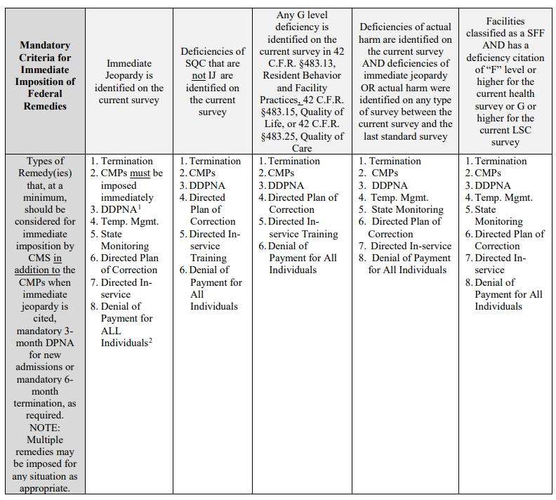
Nursing Facility Enforcement
Mandatory Criteria for Immediate Imposition of Federal Remedies

Slide 13
Nursing Facility Enforcement
Federal Fees, Fines and Other Remedies
7305ˌ2ˌ1 - Who Sends the Formal Notice of Remedies
(Rev. 213; Issued: 02-10-23; Effective: 02-10-23; Implementation: 02-10-23)
A formal notice of remedies is sent by:
a. The State, in either its initial notice or in its first revisit notice for category 1 remedies and denial of payment for new admissions, when and as authorized by CMS and/or the State Medicaid Agency;
b. The CMS Location for remedies other than those provided in accordance with 1a. above; for skilled nursing facilities, skilled nursing facilities/nursing facilities, and nursing facilities where the CMS Location is taking the enforcement action; and/or,
c. The State Medicaid Agency for remedies other than those provided in accordance with a. above for nursing facilities.

Slide 14
Nursing Facility Enforcement
Federal Fees, Fines and Other Remedies
7305.2.3 - Required Time Periods for Formal Notice
(Rev. 63, Issued: 09-10-10, Effective: 09-10-10, Implementation: 09-10-10)
The notice period begins once the facility receives its notice as indicated below.
Immediate Jeopardy – 2 calendar day notice
Except for civil money penalties and State monitoring, notice must be given at least 2 calendar days before the effective date of the enforcement action.
No Immediate Jeopardy – 15 calendar day notice
Except for civil money penalties and State monitoring, notice must be given at least 15 calendar days before the effective date of the enforcement action.

Slide 15
Nursing Facility Enforcement
Federal Fees, Fines and Other Remedies
Lower Range of Penalty Amounts for Per Day Civil
Money Penalty
Penalties in the range of $50 to $3,000 per day may be imposed when immediate jeopardy does not exist, but the deficiencies either caused actual harm, or caused no actual harm, but have the potential for more than minimal harm. A civil money penalty may not be less than $50.00 per day.
Upper Range of Penalty Amounts for Per Day Civil Money Penalty
Penalties in the range of $3,050 to $10,000 per day may be imposed for deficiencies constituting immediate jeopardy. Penalties may also be in the upper range of penalty amounts for deficiencies when immediate jeopardy does not exist if a penalty in the lower range of penalty amounts was previously imposed and the deficiencies in the same regulatory grouping are repeated. Repeated deficiencies are defined in §7516.3.
Range of Per Instance Penalty Amounts
Penalties in the range of $1,000 to $10,000 per instance(s) may be imposed for noncompliance that constitutes actual harm, or for noncompliance that has the potential for more than minimal harm. The terminology “per instance” is not used to suggest that only one instance of noncompliance may be assigned a civil money penalty. There can be more than one instance of noncompliance identified during a survey where the State utilizes the per instance civil money penalty as an enforcement remedy. The total dollar amount of the civil money penalty for the instance or multiple instances of noncompliance may not exceed $10,000 for that specific survey, and may not be less than $1,000 per instance.

Slide 16
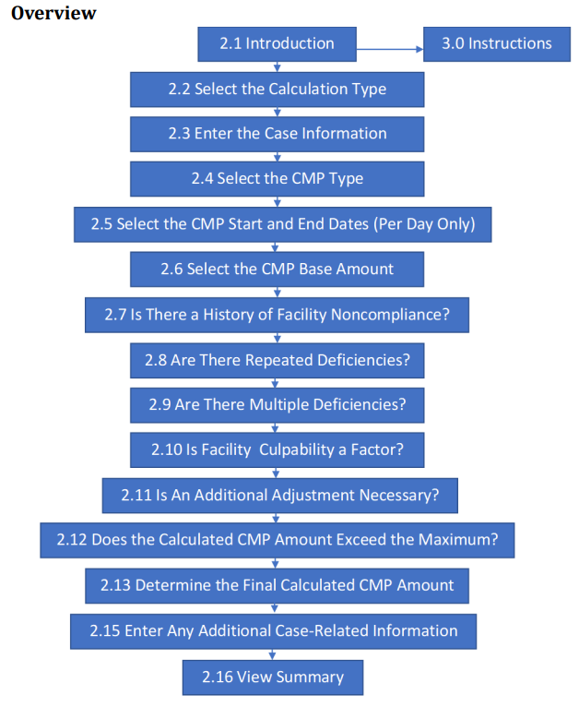
Nursing Facility Enforcement
CMP Analytic Tool and User Guide
All CMS locations are required to use the following CMP Analytic Tool and Instructions:
to choose the appropriate type of CMP to be imposed; and
(2) to calculate the CMP amount, when the CMS location determines that a CMP is an appropriate remedy to impose.
The CMS location must complete all sections of the tool that apply to the type of CMP selected. Please refer to the CMP Analytic Tool User’s Guide for information about using this tool. Though remedies are usually imposed on Level 3 and Level 4 deficiencies, depending upon the circumstances, CMS locations may impose CMPs for level 2 deficiencies based on the factors listed in 42 CFR 488.404 and 488.438(f).

Slide 17
CMPs, NATCEP and other Enforcement Remedies
NATCEP
The Centers for Medicare and Medicaid Services (CMS) recently directed Kansas Department for Aging and Disability Services (KDADS) to change the way the Nurse Aide Training and Competency Evaluation/Competency Evaluation Program (NATCEP/CEP) disapproval criteria is applied to findings of past noncompliance (PNC). KDADS was informed that a PNC deficiency that meets Substandard Quality of Care (SQC) requirements, as defined in 42 CFR 488.301, is considered a triggering event for NATCEP/CEP disapprovals.
For questions or more information regarding this direction from CMS please reach out to Patricia Purdon at patricia.purdon@ks.gov
Notes:
Current for 10/7/2024

Slide 18
Adult Care Home Enforcement
Fees, Fines and Other Remedies
Adult Care Home Remedy Authority begins at KSA 39-945 and include:
Correction Order
Civil Penalty
Ban on Admissions
Licensure Denial, Suspension and Revocation

Slide 19
Adult Care Home Enforcement
Civil Penalties
Maximum finable amount is $500 per day per deficiency but the maximum assessment shall not exceed $2,500*.
Factors for determining fine amount:
The severity of the violation;
the good faith effort exercised by the adult care home to correct the violation; and
the history of compliance of the ownership of the adult care home with the rules and regulations.
*If the secretary for aging and disability services determines that an adult care home is in violation of or has violated any requirements, standards or rules and regulations established under the adult care home licensure act which violation can reasonably be determined to have resulted in, caused or posed serious physical harm to a resident, the secretary for aging and disability services in accordance with proceedings under the Kansas administrative procedure act, may assess a civil penalty against the licensee of such adult care home in an amount of not to exceed $1,000 per day per violation for each day the secretary finds that the adult care home was not in compliance with such requirements, standards or rules and regulations but the maximum assessment shall not exceed $10,000.

Slide 20
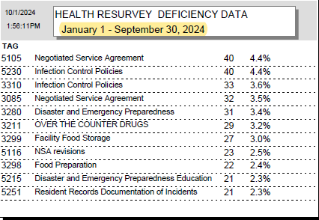
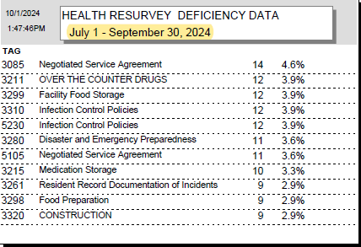
Top Cited Deficiencies
State Licensed Only
Notes:
Current for 10/7/2024

Slide 21
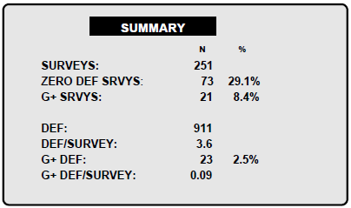
Survey Consistency
State Licensed Only
Notes:
Current for 10/7/2024

Slide 22
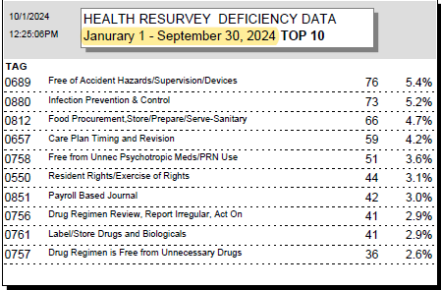
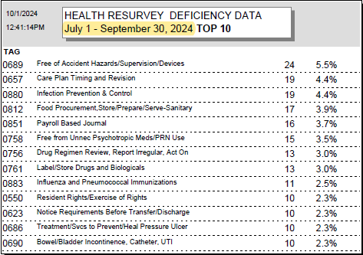
Top Cited Deficiencies
Nursing Facilities
Notes:
Current for 10/7/2024

Slide 23
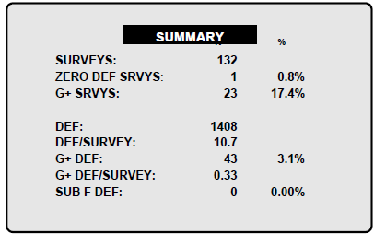
Survey Consistency
Nursing Facilities
Notes:
Current for 10/7/2024

Slide 24
Staff Contacts
Lacey Hunter- Commissioner lacey.hunter@ks.gov
Dawne Altis- Assistant Commissioner dawne.altis@ks.gov
Patty Purdon- License & Enforcement Mngr patricia.purdon@ks.gov
Complaint Hotline – kdads.complainthotline@ks.gov
John Easley- Physical Environment john.easley@ks.gov
Lori Mouak- RAI – C lori.mouak@ks.gov
Jessica Patterson- Training/Recruitment jessica.patterson@ks.gov
Mary Tegtmeier- State Licensed Only QI mary.tegtmeier@ks.gov

