Slide 1
Nursing Facility Collaboration
Fourth Quarter | October 22, 2024
Notes:
General Guidelines
PowerPoints must be reviewed by Communications before being presented for the first time. Please send completed PowerPoints to Philip Harris at least three business days before the presentation. For presentations that are part of conferences where more than ten KDHE employees presenting, please allow no less than 7 business days. All PowerPoints must be on an approved KDHE template, or the one provided by the conference organizer. By submitting a presentation for review you acknowledge that you have read, and to the best of your ability followed the guidelines presented below.
• PowerPoint templates are located on the KDHE intranet.
• Follow the 7 x 7 rule; try to place no more than 7 words per line and have no more than 7 lines of text.
• Font should all be Arial, except the mission statement in the footer of each slide.
• Header font size should be at least 36 pt., while body font size should be at least 18 pt.
• Photo sources may be 8 pt. font.
• Please include the Presentation Name, Presenter First and Last Name their credentials, if any, and the date (Month Day, Year) on title slide.
• Strongly consider including a head shot of the presenter at either the beginning or end of the presentation with their contact information (Name, Title, Phone Number and Email Address). Head shots are free for agency staff, contact Brandon Clasen at Brandon.Clasen@ks.gov to get yours taken.
• Please do not change the existing color scheme.
• Please do not include URL links, unless the PowerPoint is being used digitally.
• Please do not use any clip art or photos pulled off the internet. KDHE Communications has a subscription to iStock. These high-quality photos are available to programs at no cost. To obtain photos, first search the Agency Image Library on KDHE intranet, download and use what you need. To obtain photos email Kynedee Hodges at Kynedee.Hodges@ks.gov; or place the link of the iStock photo into the slide where you would like the image added. Exceptions are made when the agency cannot shoot or purchase a certain image, and you are responsible for providing proper credit to the source of the photo.

Slide 2
Agenda
Welcome
Please place your name and which facility your associated with in the chat while waiting for the meeting to start
NF to HCBS transitions
KDADS staff will be present
Positive vs Negative Changes
Medicaid pending or active vs non-active
Completing MS-2126s
Document Upload Portal vs Consumer Self Service Portal

Slide 3
Institutional Transition
Nursing Facility to Home and Community Based Services (Assisted Living)
Allows for no gap between Institutional and HCBS coding
Must be approved by KDADS prior to discharge
ES-3160 from KDADS as well as MS-2126 discharge from the Nursing Facility is required before eligibility can be modified
FE, PD, IDD, and BI waivers are allowable institutional transitions waivers
The MCO or State Hospital Discharge Planner initiates the referral process and coordinates with KDADS.
Notes:
MKEESM 8218 Institutional Transitions - The intent of the Institutional Transition program is to transition eligible individuals from Medicaid approved institutional care settings into the community and onto HCBS waiver services (see 8112). Individuals must be eligible for Medicaid and functionally eligible for one of the following HCBS waivers: Frail and Elderly (FE), Physical Disability (PD), Intellectual and Developmental Disability (I/DD), or Brain Injury (BI).
The MCO or State Hospital Discharge Planner is responsible for initiating the referral process and shall send a request for institutional transition to the HCBS Transition Specialist. The functional assessment will be conducted by the assessing entities that currently serve each of the HCBS waiver populations specified above. The HCBS Transition Specialist will notify eligibility staff of eligible individuals via the ES-3160.
For individuals eligible for institutional transition, HCBS begins the date the individual transitions from an institutional living arrangement to community living, if approved by the HCBS Transition Specialist. (See 8200.2).
Ongoing case management will also be provided by the care coordinator. Eligibility staff are responsible for informing the care coordinator concerning the Medicaid eligibility decision, the amount of any client obligation, and any changes in obligation or eligibility. The care coordinator is responsible for providing information to eligibility staff concerning the person-centered service plan, the cost of the care, and any changes in that care or in the client’s living arrangement. The shall be used for these purposes.

Slide 4
Positive vs Negative Changes
Positive Change
No coverage or existing coverage replaced with better coverage
Example: Adding Nursing Facility coding
Decrease to a patient liability
Adding a Medicare Savings Program
Negative Change
Increasing an existing patient liability
Terminating or ending coverage
Excludes Living Arrangement changes such as removing Nursing Facility coding after discharge
Notes:
If the case is closed, then positive and negative change does not apply.

Slide 5
Medicaid Status
Medicaid Pending
Individuals with no coverage in KMAP and a valid Medicaid Application
MS-2126 only does not equal Medicaid Pending
Medicaid Applications with denials rendered
Denials for Failure to Provide receive 12 additional days from the date the notice is initiated to supply the missing information without requiring a new application
Denials for Ineligibility such as excess resources do not receive an additional 12 days. If the application is more than 45 days old, a new application will be required.
Information submitted after a denial does not automatically change the status to pending
Notes:
1414.2 Denial - A denial shall be processed to assure that the applicant is provided with his/her denial notice in a timely manner. A notice of denial shall be sent at the time of denial, explaining clearly the reason for the denial.
1. Found Ineligible-
a. An application shall be denied if the applicant is found to be ineligible (i.e., excess income, excess resources, etc.) as soon as possible, but not later than 45-days following the date the application was filed.
b. A denied application may be reinstated without a new application any time within the original 45 day processing time line. See also 1414.2 (3).
In no case does the denial of the application abridge that individual's right to reapply at any time.
2. Reserved
3. Failure to Provide Required Information/Cooperation - An application shall be denied after a period of 12-days from the date of a written request for information, but no later than 45-days from the date of application when the applicant has failed to provide required information or cooperate with eligibility requirements. The applicant must be informed in writing of the 12 day standard and the date by which the verification/cooperation must be received.
If the information is subsequently received or the household cooperates within the 45 day application processing time period, the application shall be reactivated and, if eligible, benefits prorated from the date of application. If the information/cooperation is not received within the above time frames, then the client must re-apply.
If the requested information/cooperation is not received within the 45-day application processing time period, but is provided within 12-days of the date of denial, the application shall be reconsidered and processed based on the original application date. This gives the applicant the later of 45-days from the date of application or 12-days from the date of denial to provide the information.
9110 Household Responsibility Prior to Approval - Applicants must report all changes of circumstances prior to case approval. For changes which occur before the date of the notice of approval, change reporters must report within 10 calendar days from the date of the approval notice. The worker is responsible for requesting or otherwise obtaining other information or verifications necessary to determine the household's eligibility or benefit amount for any month.
This provision applies to both new applications and applications filed after a break in assistance of one or more months.

Slide 6
Completing MS-2126 Forms
MS-2126 Forms
Complete fully within 5 days of admission or discharge
Do not submit duplicate forms
If coding has not changed, contact your designated unit
New forms Not required
For short term (less than 30 days) discharge to a hospital
Excludes swing beds or those that permanently discharge with no plan to return
To go from a temp stay to permanent stay
Eligibility will be processed by initial expected length of stay and automatically convert upon the 3rd month.
Refer to 06.20.2024 recording / notes regarding specifics of living arrangement changes

Slide 7
Portals
Consumer Self-Service Portal (SSP)
Portal for Kansas Medicaid members where member can:
Apply for coverage
Submit a review
Upload supporting documents to their case (excluding applications and reviews)
Submit changes to case
Review notices that were sent
Opt in or out of text messaging.
Self Service Portal Home Page (ks.gov)
Submitter Role
Help members apply
The Signature Page must be properly signed and attached at the time of submitting the application
Does not receive updates or notices
Medical SSP Demos on Vimeo is a helpful link on how to complete the online application
KDHE Document Upload Portal (DUP)
Portal for approved entities to assist Kansas Medicaid Members where they can
Upload supporting documents to a member's case (excluding applications and reviews)
Submit changes to case - such as MS-2126, an expense, etc.
Must have the members case number and date of birth
You can email your designated unit to obtain this.
Ability to save proof of submission
Not the same as the KDADS portal to upload functional information for special admissions, Level I, Level II, etc.
Doc Upload Portal (ks.gov)
Document Upload Portal Manual

Slide 8
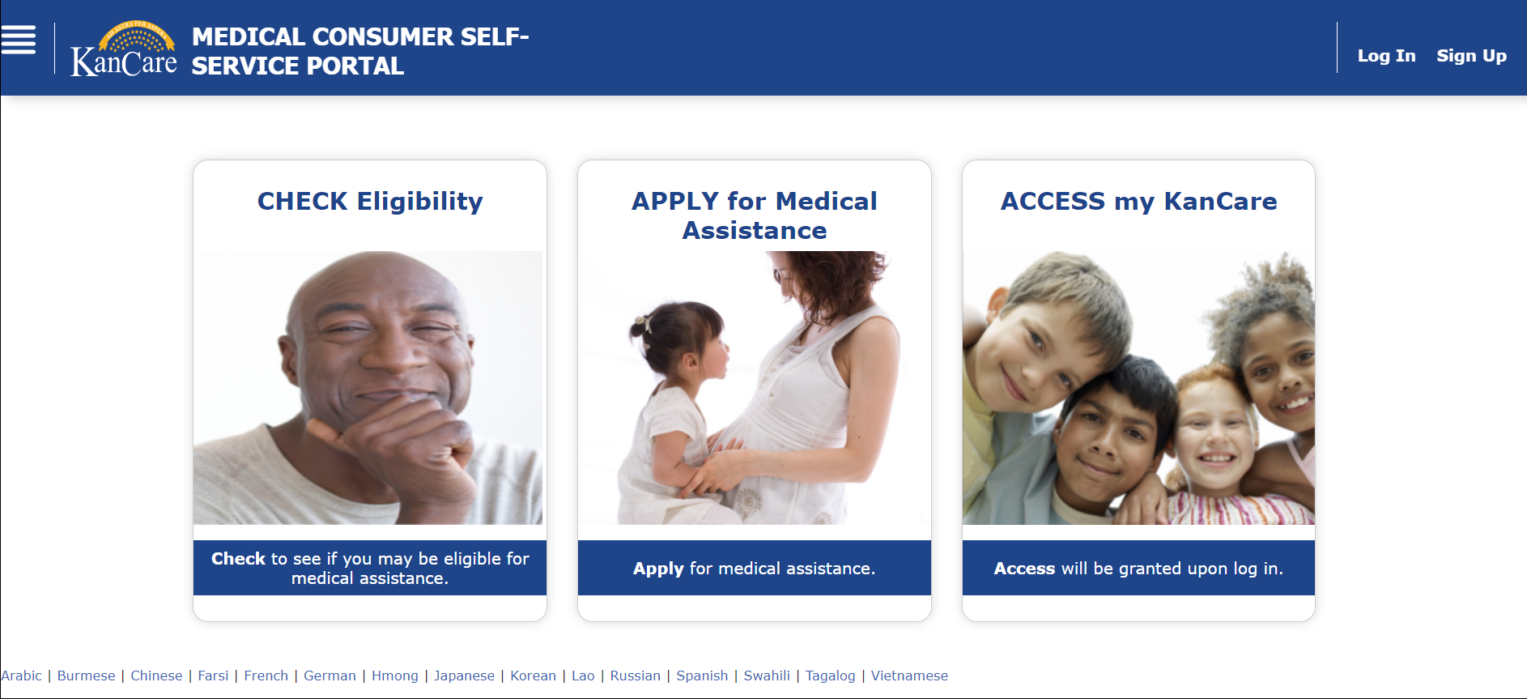
KanCare Update
Consumer Self-Service Portal (SSP)
KDHE has resources to help with the SSP:
Video guides for signing up, logging in and completing other actions - vimeo.com/showcase/8602150.
Written instructions: kancare.ks.gov/docs/default-source/home/unwinding-faq.pdf?sfvrsn=6660521b_12 (page 4).
Call 1-877-782-7358 for further assistance.

Slide 9
Title of Presentation Goes Here
Questions

