Slide 1
HCBS Collaboration
Third Quarter | August 6, 2025
Notes:
General Guidelines
PowerPoints must be reviewed by Communications before being presented for the first time. Please send completed PowerPoints to Philip Harris at least three business days before the presentation. For presentations that are part of conferences where more than ten KDHE employees presenting, please allow no less than 7 business days. All PowerPoints must be on an approved KDHE template, or the one provided by the conference organizer. By submitting a presentation for review you acknowledge that you have read, and to the best of your ability followed the guidelines presented below.
• PowerPoint templates are located on the KDHE intranet.
• Follow the 7 x 7 rule; try to place no more than 7 words per line and have no more than 7 lines of text.
• Font should all be Arial, except the mission statement in the footer of each slide.
• Header font size should be at least 36 pt., while body font size should be at least 18 pt.
• Photo sources may be 8 pt. font.
• Please include the Presentation Name, Presenter First and Last Name their credentials, if any, and the date (Month Day, Year) on title slide.
• Strongly consider including a head shot of the presenter at either the beginning or end of the presentation with their contact information (Name, Title, Phone Number and Email Address). Head shots are free for agency staff, contact Brandon Clasen at Brandon.Clasen@ks.gov to get yours taken.
• Please do not change the existing color scheme.
• Please do not include URL links, unless the PowerPoint is being used digitally.
• Please do not use any clip art or photos pulled off the internet. KDHE Communications has a subscription to iStock. These high-quality photos are available to programs at no cost. To obtain photos, first search the Agency Image Library on KDHE intranet, download and use what you need. To obtain photos email Kynedee Hodges at Kynedee.Hodges@ks.gov; or place the link of the iStock photo into the slide where you would like the image added. Exceptions are made when the agency cannot shoot or purchase a certain image, and you are responsible for providing proper credit to the source of the photo.

Slide 2
Agenda
Welcome
Please place your name and which organization you're associated with in the chat while waiting for the meeting to start
Spreadsheet Communication Process
Due and Owing Medical Expenses
Proactive Communication
Review Reconsideration Policy July 2025

Slide 3
Spreadsheet Communication Process
Preferred Method
Only include cases that have a specific question or concern.
  Ensure all fields are filled out, if information is known.
Always send the spreadsheet via encrypted email for security.
Clearly indicate the dates impacted and provide a concise description of the concern or issue.
Avoid Redundant Updates: If the previous status update hasn’t been fulfilled or the individual is already active with the correct level of care, please do not submit a new status request.
  Example: If the prior week’s note indicated a new application was needed, and one has not yet been submitted, the case should not appear on the current spreadsheet.
Wait for a response to your current submission before sending another spreadsheet
For efficiency and tracking purposes, submit all questions via the designated spreadsheet rather than sending multiple separate emails. Exception: Case number request
If no response (or inadequate response) is provided within two full business days, contact Rachelle Altman or Breanna Dohrman.
Notes:
MKEESM 8172.1 (2)Due and Owing – unpaid portion, allowable if was applied towards a SD but SD not met, ALF medical portion. Cost of Share never allowed. (3) Allowable Expenses – Services must be current/verified/itemized to be allowed.

Slide 4
Due and Owing Medical Expenses
Client Obligation or Cost of Share
  KDHE cannot provide the calculation of a client obligation using specifics without a valid facilitator form or release.
  Calculation is gross income – $20 unearned income disregard - allowable medical expenses – $2901 Protected Income Limit (F-8 Appendix)
  If the client obligation is $0 based on income alone, then it cannot be reduced further
Itemized Statement
  Room and Board is never allowable for assisted living PC-2017-06-01
  If medical expenses are separated from room and board, then it can be potentially be allowed PC-2019-02-01
  A past due cost of share can never be allowed to reduce a future cost of share
  Must be a medical necessity
  MKEESM 8270
Notes:
MKEESM 1413 Time in which Application is to be Processed and Case Disposition.
MKEESM 1411 Submittal of a signed paper, online, telephonic app is considered a request for assistance.
MKEESM 8184.1 The MS-2126
MKEESM 8114 CARE Assessment Process and Eligibility

Slide 5
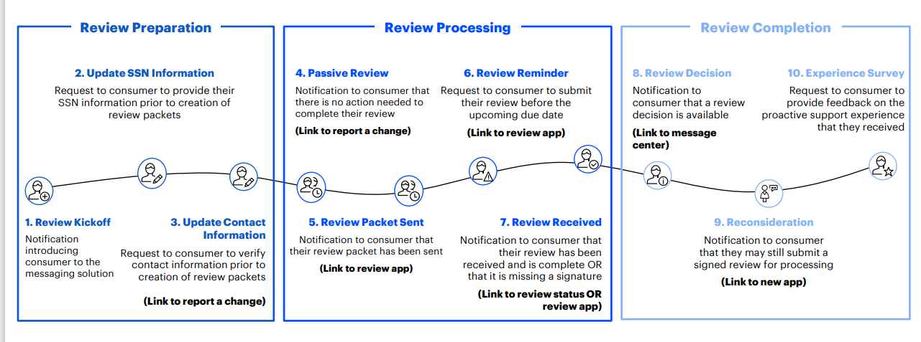
Proactive Communication
Proactive Communication Journey
Notes:
Members not updating their address with Social Security can cause benefit disruptions or change in benefit amount. The agency relies on the member reporting their changes with SSA.

Slide 6
Review Reconsideration Policy July 2025
Untimely (treated as an application)
Submitted after the month due
Prior medical must be requested to fill any gaps
  Not automatic any longer
Timely
Submitted prior to the last day of the month it is due
No gap in coverage
System will automatically close those not received around 16th of the month
  Timely / Adequate notice policy requirements
If submitted or registered after the systematic closure, coverage can be reinstated while waiting for a determination
  Manual reinstatement, processes in place to identify; however, can email spreadsheet to direct unit
PM2025-07-01
Notes:
MKEESM 7430 PIL
MKEESM Eligibility Periods – shortening a base period
MKEESM 8173 Continue Financial Eligibility IL to NF etc.
New MD PIL > $967 effective July 1st

Slide 7
Title of Presentation Goes Here
Questions

