Slide 1
U.S. Health and Human Services COVID-19 Testing Program
Maleah Slaughter – Minnesota/ Kansas State Lead

Slide 2
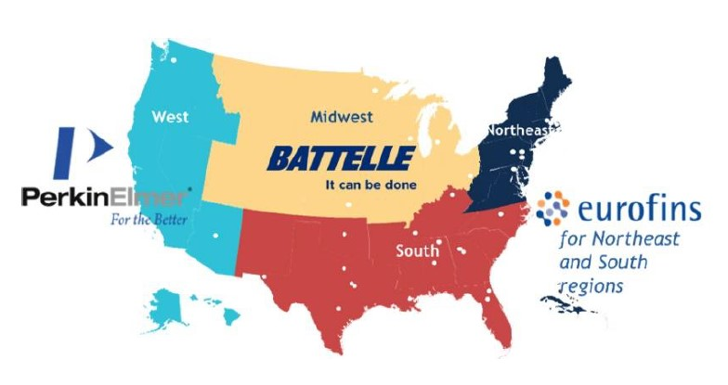
Program Purpose and Overview
U.S. Department of Health and Human Services (HHS) is funding four regional coordination centers providing expanded COVID-19 testing access to help schools and congregate settings safely reopen, remain open, and reach underserved populations
All supplies, shipping, and testing are free of cost
Midwest Coordination Center (MCC) provides COVID-19 testing in 16 Midwestern states
Sites are registered and paired with certified partner laboratories that provide FDA authorized standard RT-PCR testing authorized under FDA Emergency Use Authorization
Serial screening tests of individuals who have no symptoms help quickly identify potentially contagious cases and prevent further transmission or future outbreaks

Slide 3
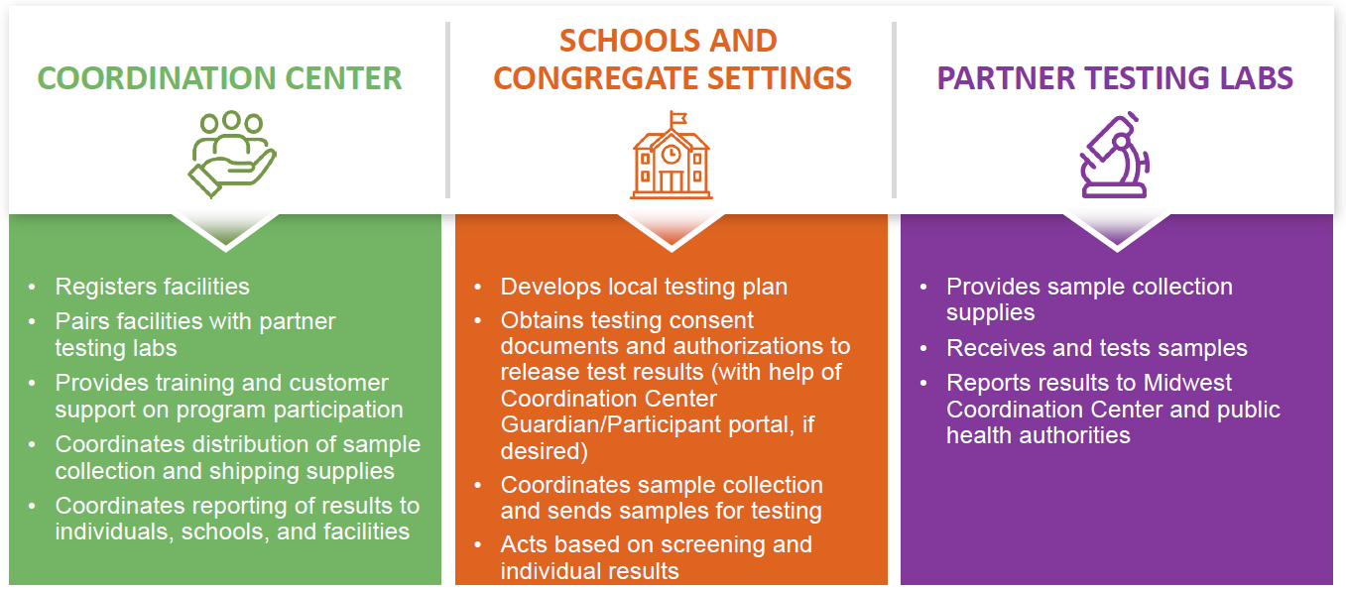
How it Works

Slide 4
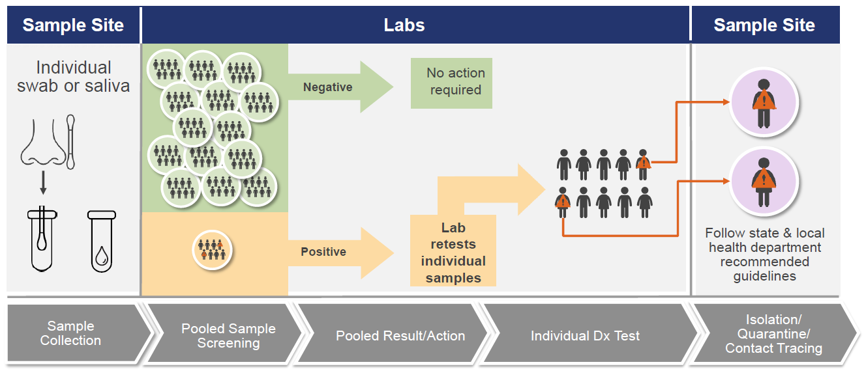
Testing Overview

Slide 5
Testing Plan

Slide 6
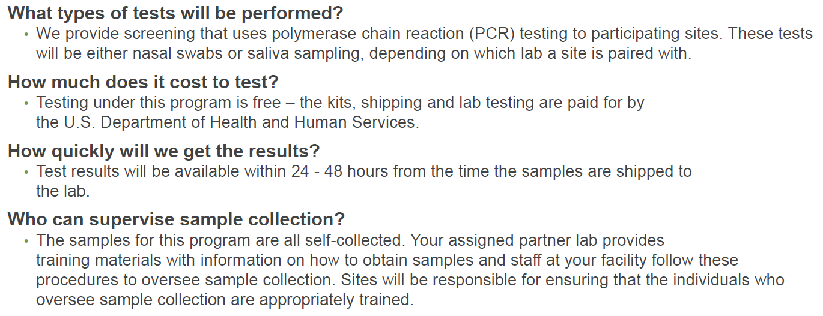
FAQs – General Testing

Slide 7
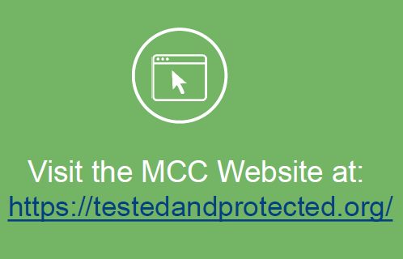
Our contact information
State Contacts:
MN/ KS State Lead – Maleah Slaughter
Email: slaughterm@testedandprotected.org
Direct Number: 614-424-3381
MN/ KS State Liaison – Ashley Bero
Email: bero@testedandprotected.org
Direct Number: 614-424-3631

