Slide 1
Testing Program Management
Meeting
May 11, 2023

Slide 2
Status of KDHE Response to COVID-19 after Public Health Emergency
COVID-19 Testing Funding
COVID-19 testing programs for K-12 schools, early childcare settings, jails, homeless shelters, Community and Volunteer Testing programs, and testing through state contracted reference laboratories and through the Kansas Health and Environmental Laboratories (KHEL) will continue past the PHE ending. At this time, an end date has not been determined.
KDHE will end its partnership with Project ACT for free COVID-19 tests on June 30, 2023. These free tests are available to Kansans in all zip codes in the state. Individuals can visit AccessCovidTests.org to order free, rapid, at-home COVID-19 test kits that will be shipped directly to their doorstep.

Slide 3
KDHE Response at the End of the Public Health Emergency
Case Investigations
KDHE will discontinue COVID-19 case investigations with the end of the Public Health Emergency on May 11. After this date, state and local public health will no longer investigate individual cases. Public Health will continue to investigate outbreaks.
Local Corrections Partnership
KDHE will continue to provide COVID-19 outbreak and infection control support to Kansas Department of Corrections and local correctional facilities past the end of the Public Health Emergency ending.

Slide 4
KDHE Response at the End of the Public Health Emergency
Case Reporting
With the end of the Public Health Emergency, SARS-CoV-2 laboratory results* and COVID-19 case reports will no longer be reportable to KDHE or local health departments. However, clusters or outbreaks of COVID-19 remain reportable to KDHE by contacting the 24/7 KDHE Epidemiology Hotline at 877-427-7317, option 5. This will allow public health officials to aid in outbreak containment by providing free of charge testing, infection prevention guidance, and technical assistance to interrupt disease transmission.
*Testing partners, including Community Testing Partners and reference laboratories
contracted by the State of Kansas, should continue to send results. Contact your KDHE program manager with any questions on reporting.
KDHE will move to surveillance monitoring of COVID-19 disease, similar to how the agency monitors influenza activity in the state. This includes monitoring syndromic surveillance data for near-real time emergency department visits, monitoring death registration data, and working to establish an outpatient COVID-19 like illness network.

Slide 5
KDHE Response at the End of the Public Health Emergency
Dashboards
The COVID-19 Cases in Kansas Dashboard will continue to update the dashboard weekly with available data through the month of May. Beginning June 1, KDHE will change the publicly available data to reflect new data sources including syndromic surveillance and death registration.
The Kansas Vaccine Data Dashboard will continue to update the dashboard weekly with available data through the month of May. Beginning June 1, KDHE will update the dashboard monthly. KDHE will discontinue providing weekly and monthly datasets, this will move to a request process. To submit a request contact Andrea.May@ks.gov
COVID-19 Website
KDHE is working to develop a COVID-19 section within the existing KDHE website. The existing COVID-19 website will be decommissioned and all available resources will be located on the KDHE website. A date for the decommission of the website has not been determined.

Slide 6
KDHE Response at the End of the Public Health Emergency
Health Care and Long-Term Care Facilities
KDHE will continue to provide guidance on testing, isolation, Personal Protective Equipment (PPE) usage and reporting requirements to health care facilities through KDHE’s Healthcare-Associated Infections & Antimicrobial Resistance (HAI/AR) Program. The HAI/AR Program will continue to assist facilities in their role to control COVID-19 in their facilities.
KDHE will continue to assist Long-Term Care Facilities with emergency staffing if they are experiencing a COVID-19 outbreak past the end of the Public Health Emergency ending. At this time, an end date has not been determined.

Slide 7
From the CDC Director
Updates on how CDC will approach COVID-19 surveillance after the public health emergency ends
  CDC is thinking about this data through four streams: testing, cases, hospitalizations, and vaccinations:
    The biggest changes are with testing data. Individual labs will no longer be required to report positive or negative tests to jurisdictions. The data you will have to share and what CDC will have to share will be limited.
    Many states will move away from aggregate case reporting. CDC will continue to work with states to set the cadence for receiving case numbers while recognizing the limitations.
    Hospitalization reporting will continue for the foreseeable future. CDC will continue to share data with you to help understand the severity of disease in your jurisdictions.
    CDC is working with states to set up data use agreements for both COVID-19 and routine vaccinations.
    CDC will continue SARS-CoV2 weekly genomics reporting.
  Additional innovations and advancements such as wastewater surveillance will continue to be developed. CDC is examining how to expand wastewater surveillance to other diseases. They are also expanding syndromic surveillance and emergency department visits.
https://covid.cdc.gov/covid-data-tracker/#cases_new-admissions-rate-county

Slide 8
CDC Updates: End of the Public Health Emergency
CDC’s authorization to receive certain types of data expires with the end of the PHE. Because of the data changes, and CDC’s most recent understanding of COVID-19, you will see changes to surveillance activities, data visualizations, and reporting:
  COVID-19 Community Levels (CCLs) and Community Transmission Levels, both of which are supported by case data, will be discontinued.
  A recent MMWR outlines strong evidence for a shift to hospital admissions as our primary surveillance metric for COVID-19. Over the last year, we saw a 99% correlation between COVID-19 community levels and hospital admissions. A trend analysis has shown that changes in case data and hospital admission levels can similarly be monitored to identify rising rates of severe COVID-19 in a community at both the county and state levels. CDC’s COVID-19 hospital admission levels will go live the evening of May 11, 2023.
  Along with the COVID-19 hospital admission levels, CDC continues to provide recommendations that people, especially those at high risk of severe COVID-19, can use to determine how best to protect themselves.
  CDC will also use emergency department visits, test positivity through a sentinel network, and wastewater data to look at changes in transmission.
  CDC will add a new COVID-19 severity indicator, which is percentage of deaths associated from COVID-19. Data will come from their national vital statistics system.
  https://www.cdc.gov/mmwr/volumes/72/wr/mm7219e1.htm?s_mm7219e1_w

Slide 9
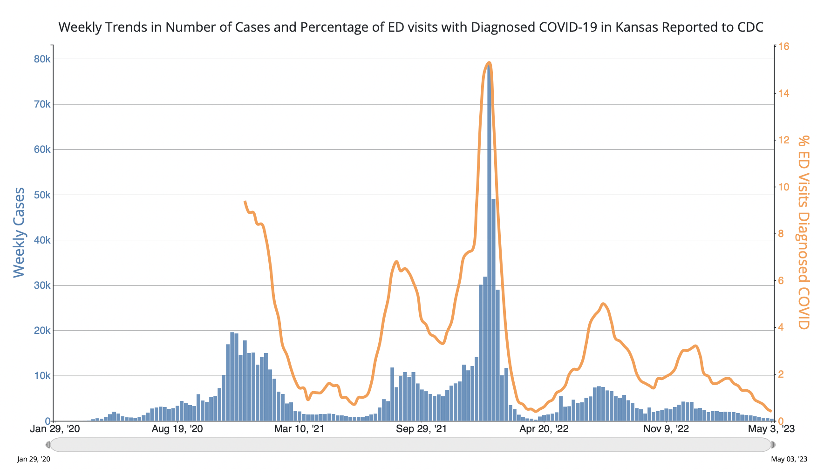
https://covid.cdc.gov/covid-data-tracker/#trends_weeklycases_7dayeddiagnosed_20

Slide 10
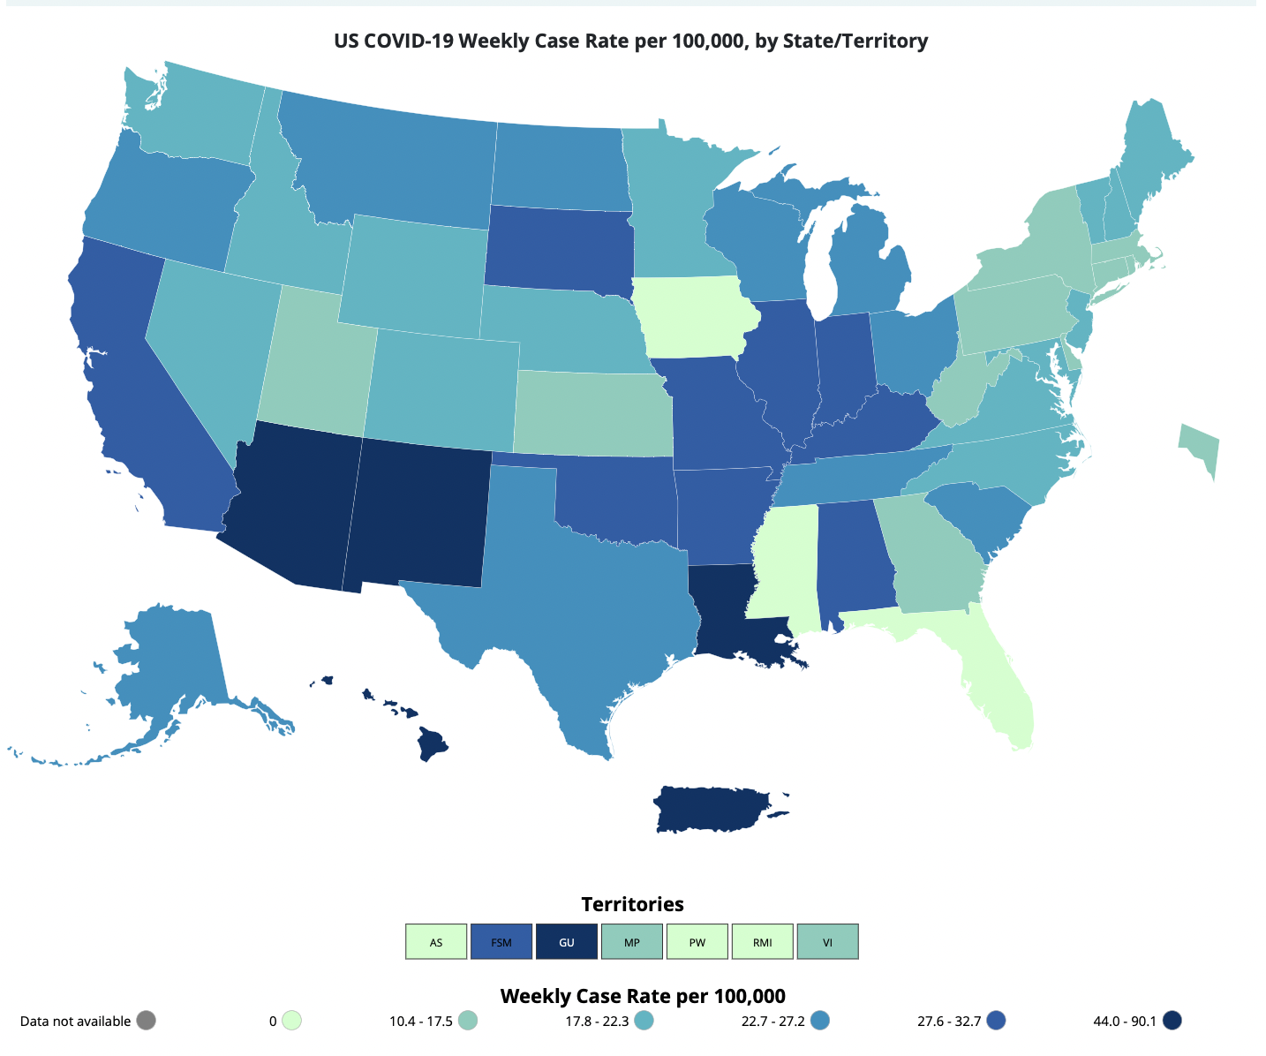
COVID-19: Situation in the US
Total Cases: 104,618,931
7 Day Case Rate Per 100,000: 23.3
Total Deaths: 1,131,819
Available at: CDC COVID Data Tracker: Cases, Deaths, and Testing; Data updated 5/3/2023.
Notes:
Total cases in the US as of April 5 was about 104 million since the beginning of the pandemic. CDC is now updating data once a week on Wednesdays and posting on Thursdays.
The 7 day average number of cases decreased to 23.3 increased to cases per 100,000. The last time we met we were at 36.4 cases per 100,000 population.
And the cumulative number of COVID-19 deaths is at 1,127,104.

Slide 11
Wastewater and Variant Update

Slide 12
SARS-CoV-2 in wastewater continues to remain low
SARS-CoV-2 in wastewater in 10 monitored sewersheds in Kansas remains low.

Slide 13
SARS-CoV-2 lineages detected in wastewater
Sequencing of patient samples has been reduced due to a lack of eligible samples.
In line with local and regional patient sequencing results, XBB.1.5 is the most prevalent lineage in these 10 sewersheds.
Biobot has identified XBB.1.16 and XBB.1.9.1 in Kansas Sewersheds.
2 XBB.1.9.1 case has been identified in Kansas. No XBB.1.16 cases have been identified in Kansas.

Slide 14
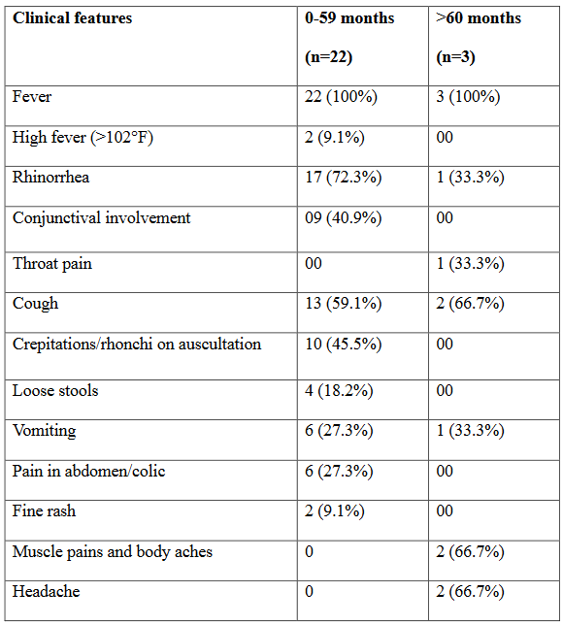
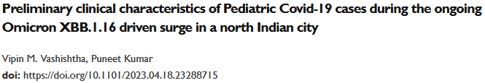
XBB.1.16 Symptoms in Children
https://www.medrxiv.org/content/10.1101/2023.04.18.23288715v1
During a time when XBB.1.16 was the dominant lineage, the authors reported that conjunctivitis was a symptom of SARS-CoV-2 in 40.9% of children < 5 years old (*note small sample sizes).

Slide 15
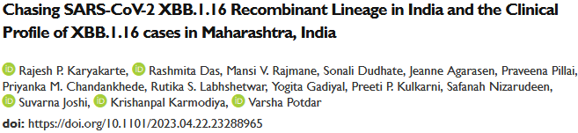
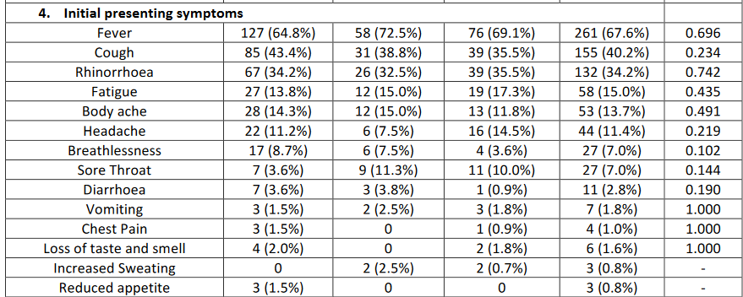
XBB.1.16 Symptoms in All Age Groups
https://www.medrxiv.org/content/10.1101/2023.04.22.23288965v1
The authors concluded that XBB.1.16 has a similar clinical presentation and outcome as compared to other Omicron lineages across all age groups.
The authors did not report on conjunctivitis.
Notes:
Aka “Arcturis”

Slide 16
Community and Volunteer Testing and KDHE supported COVID anti-viral availability at community pharmacies

Slide 17
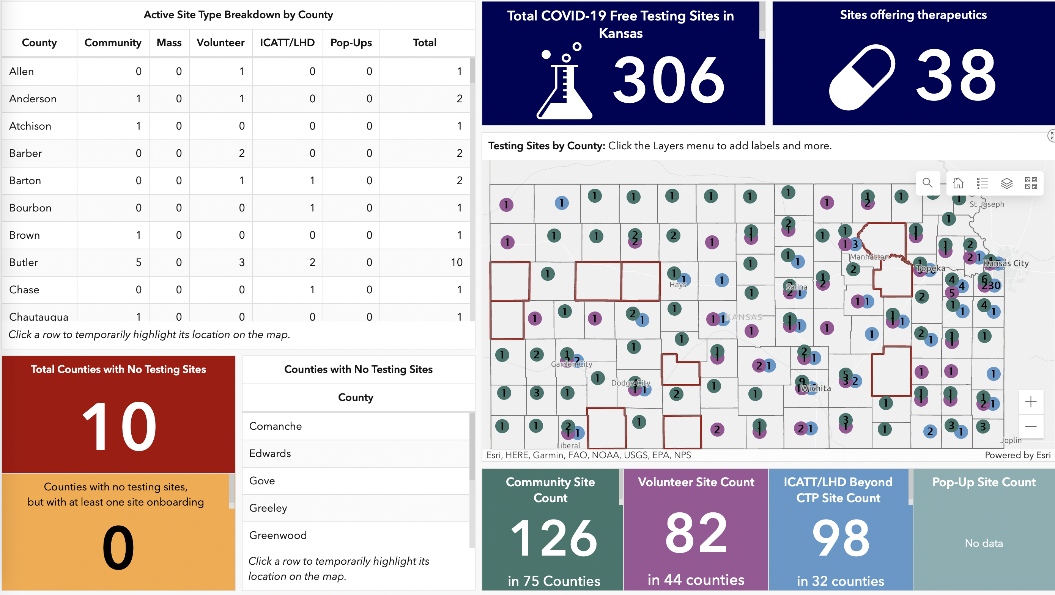
To locate a free testing site or location of COVID anti-viral treatment: www.KnowBeforeYouGoKS.com

Slide 18
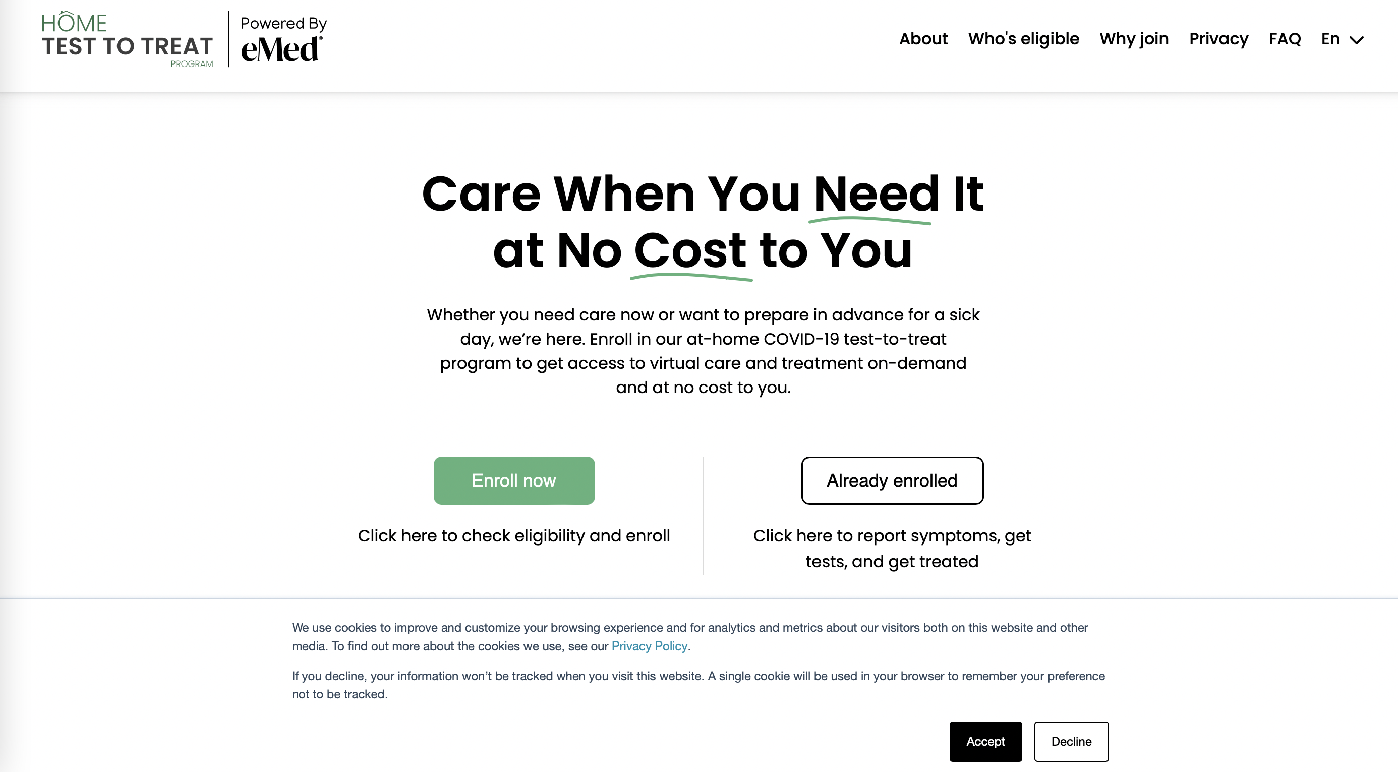
Free at-Home Access to COVID-19 Antiviral Prescriptions
www.Test2Treat.org

Slide 19
COVID-19 Test inventory at KHEL
Test on hand:
OTC 55,000
POC > 1 million
300 K expire August
500K expire Sept.-Dec
100,000 expire Jan-Mar 2024
Accula expired – no longer available.
No kits on order.
Last purchase we made was in early January 2023
- to support school testing with the COVID + Flu tests.
Previous orders in January 2022 (Omicron surge).
Shipped ~75k in December.
Shipped about 30k in January and 30k in February
Assuming a 50k per month shipment (generous),
Need to ship 750k tests between now and April 2024.

Slide 20
Project ACT Updates
Project ACT – Access COVID Tests
Rockefeller Foundation, KDHE, CareEvolution, iHealth, and Amazon.com
Increase access to testing in vulnerable populations
-Farmworkers, people in high SVI areas, and testing deserts
Order online for Amazon delivery – typically within 48 hours
Initially, 284 eligible zip codes in 100 counties
Now 756 in 105 counties
Website access live on 5/23/2022 at https://accesscovidtests.org

Slide 21
Project ACT Summary Week of May 8, 2023
756 zip codes in 105 counties eligible
  685 zip codes with 1+ order (91%)
  406 zip codes with 10+ orders (54%)
  71 zip codes with NO orders (9%)
  61,362 orders have placed orders as of May 9, 2023
  54,857 unique households (89% of orders placed by unique households)
  18,354 orders remaining (5 tests per order)
  Since we last met:
  Project ACT Brief and Press Release
  https://www.rockefellerfoundation.org/case-study/stopping-a-covid-19-surge-with-last-mile-testing/
  https://www.rockefellerfoundation.org/news/the-rockefeller-foundation-extends-project-act-to-continue-providing-free-at-home-covid-19-tests-to-at-risk-communities-in-six-states/
  Ends 6/30/2023

Slide 22
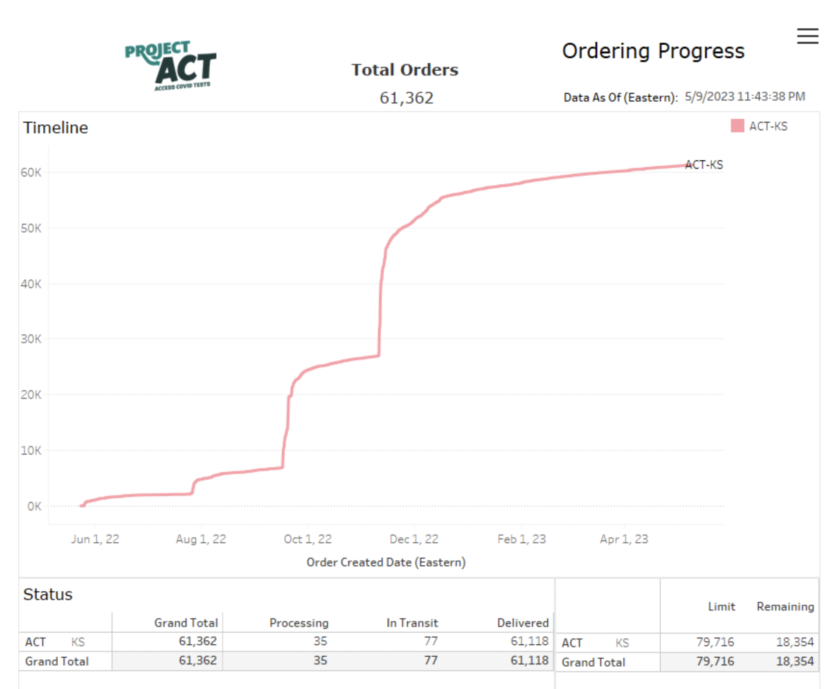

Slide 23
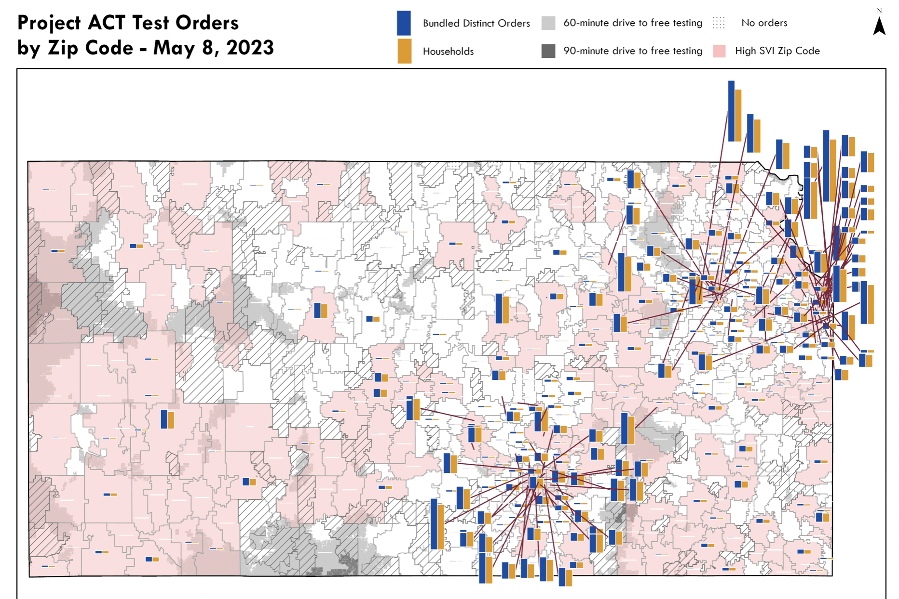

Slide 24
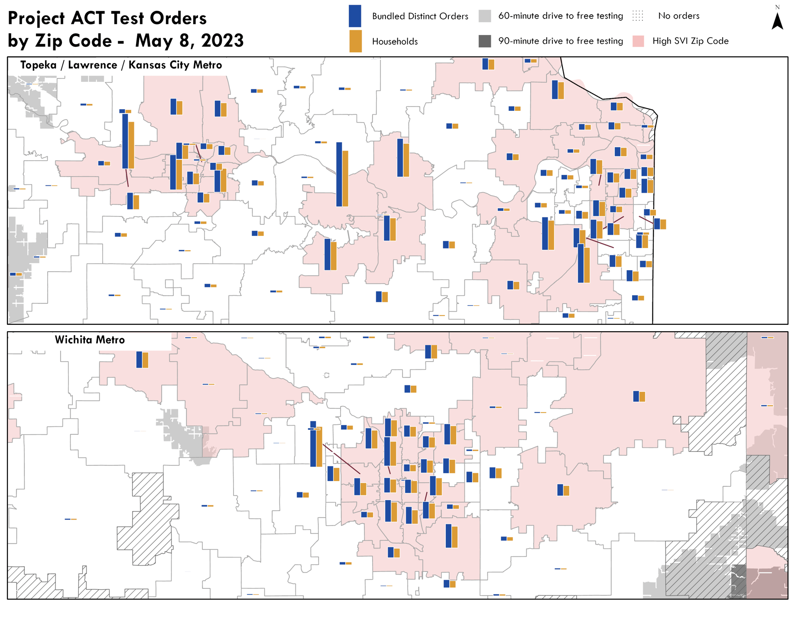

Slide 25
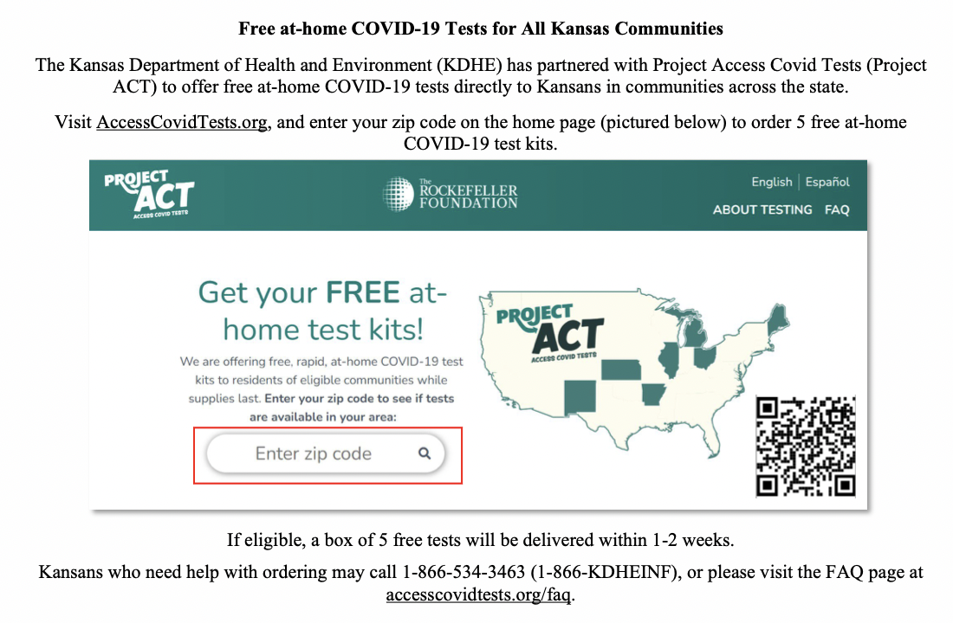

Slide 26
