Slide 1

Summary
Pulling It All Together

Slide 2
Objectives
Summary – Pulling It All Together
Discuss how to use the tools and strategies presented in this training
Demonstrate how to appropriately apply the tools and strategies in nursing home scenarios

Slide 3
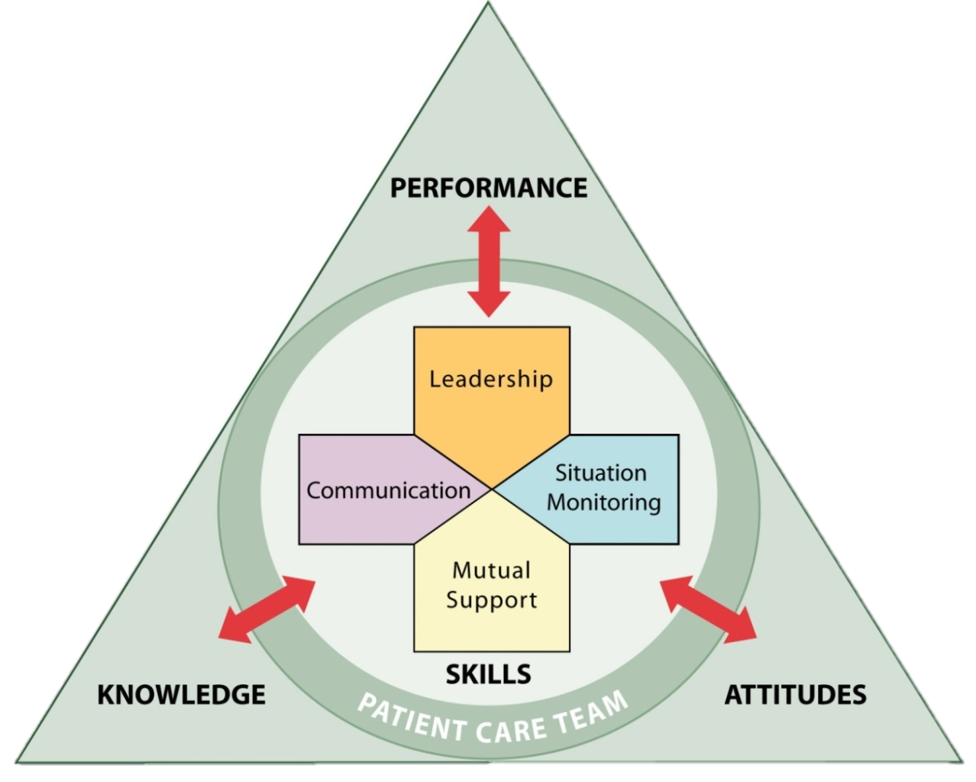
Summary
Each TeamSTEPPS teamwork skill:
  Facilitates teamwork
  Is dependent upon or moderated by the other skills
  Contributes to team performance, quality of care, and resident safety

Slide 4
Tools & Strategies Summary
BARRIERS
Inconsistency in Team Membership
Lack of Time
Lack of Information Sharing
Hierarchy
Defensiveness
Conventional Thinking
Complacency
Varying Communication Styles
Conflict
Lack of Coordination and Followup With Coworkers
Distractions
Fatigue
Workload
Misinterpretation of Cues
Lack of Role Clarity
TOOLS and STRATEGIES
  Communication
  SBAR
  Call-Out
  Check-Back
  Handoff
  Leading Teams
  Brief
  Huddle
  Debrief
  Situation Monitoring
  STEP
  I’M SAFE
  Mutual Support
  Task Assistance
  Feedback
  Assertive Statement
  Two-Challenge Rule
  CUS
  DESC Script
OUTCOMES
Shared Mental Model
Adaptability
Team Orientation
Mutual Trust
Team Performance
Resident Safety!!

Slide 5
TeamSTEPPS Outcomes
Improved team performance (e.g., Weaver, et al., 2010)
Improved patient safety culture (e.g., Thomas & Galla, 2013)
Improved scores on Quality of Life survey (e.g., Howe, 2014)

Slide 6

Skills Practice

Slide 7


Identifying Opportunities To Use TeamSTEPPS Tools and Strategies

Slide 8

Effective Use of TeamSTEPPS Tools and Strategies

Slide 9
Summary
In the preceding section, we learned that teamwork strategies and tools:
  Are available to both team members and leaders
  Can be used to address barriers to team effectiveness in a given situation
  Can all be applied to most situations because they complement one another

Slide 10

Applying TeamSTEPPS Exercise
Are there any changes you would make to your assessment of the teamwork issue that needs to be addressed in your nursing home?
If yes, what is the teamwork issue that needs to be addressed?
If you had to identify only one tool or strategy to implement first, which one would it be and why?

